Slide 1
Texture Mapping
Mahmudul Hasan

Slide 2
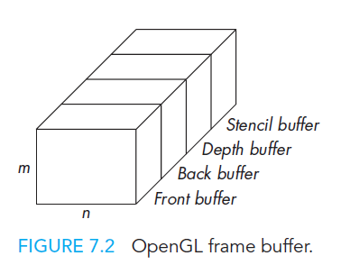
Frame Buffer
Figure 7.2 shows the OpenGL frame buffer and some of its constituent parts. When we work with the frame buffer, we usually work with one constituent buffer at a time. Thus, we shall use the term buffer in what follows to mean a particular buffer within the frame buffer. Each of these buffers is n × m and is k bits deep. However, k can be different for each buffer. For a color buffer, its k is determined by how many colors the system can display, usually 24 for RGB displays and 32 for RGBA displays.

Slide 3

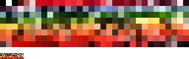
Color Palette
Framebuffers have traditionally supported a wide variety of color modes. Due to the expense of memory, most early framebuffers used 1-bit (2-color), 2-bit (4-color), 4-bit (16-color) or 8-bit (256-color) color depths.
Here is a typical indexed 256-color image and its own palette

Slide 4
Digital Images
if we are working with RGB images, we usually represent each of the color components with 1 byte whose values range from 0 to 255. Thus, we might declare a 512 × 512 image in our application program as
GLubyte myimage[512][512][3];
or, if we are using a floating-point representation,
typedef vec3 color3;
color3 myimage[512][512];

Slide 5
Digital Images
For example, suppose that we want to create a 512 × 512 image that consists of an 8 × 8 checkerboard of alternating red and black squares, such as we might use for a game. The following code will work:
class mRGB
{
public:
uchar r,g,b,a;
mRGB(){r = g = b = 0,a=255;}
};

Slide 6
Digital Images
nRows=nCols=64;
pixel = new mRGB[3*nRows*nCols];
long count=0;
for(int i=0;i<nRows;i++)
for(int j=0;j<nCols;j++)
{
int c=(( (i/8)+(j/8) ) %2)*255;
pixel[count].r=c; //red
pixel[count].g=c; //green
pixel[count++].b=0; //blue
}

Slide 7
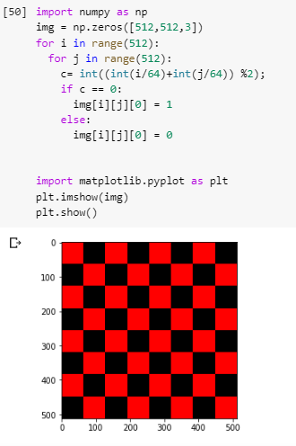
Digital Images

Slide 8
Mapping Methods
Consider, for example, the task of creating a virtual orange by computer. Our first attempt might be to start with a sphere. Although it might have the correct overall properties, such as shape and color, it would lack the fine surface detail of the real orange. If we attempt to add this detail by adding more polygons to our model, even with hardware capable of rendering tens of millions of polygons per second, we can still overwhelm the pipeline. as the implementation renders a surface—be it a polygon or a curved surface—it generates sets of fragments, each of which corresponds to a pixel in the frame buffer. Fragments carry color, depth, and other information that can be used to determine how they contribute to the pixels to which they correspond. As part of the rasterization process, we must assign a shade or color to each fragment.

Slide 9
Mapping Methods
An alternative is not to attempt to build increasingly more complex models, but rather to build a simple model and to add detail as part of the rendering process. There are three major techniques:
Texture mapping
Bump mapping
Environment mapping

Slide 10
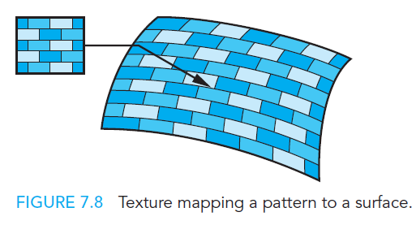
Texture Mapping
Texture mapping uses an image (or texture) to influence the color of a fragment. Textures can be specified using a fixed pattern, such as the regular patterns often used to fill polygons; by a procedural texture-generation method; or through a digitized image. In all cases, we can characterize the resulting image as the mapping of a texture to a surface, as shown in Figure 7.8, as part of the rendering of the surface.

Slide 11
Bump Mapping & Environment Mapping
bump maps distort the normal vectors during the shading process to make the surface appear to have small variations in shape, such as the bumps on a real orange.
Reflection maps, or environment maps, allow us to create images that have the appearance of reflected materials without our having to trace reflected rays. In this technique, an image of the environment is painted onto the surface as that surface is being rendered.
Color Plate 15 uses a texture map for the surface of the table; Color Plate 10 uses texture mapping to create a brick pattern.

Slide 12
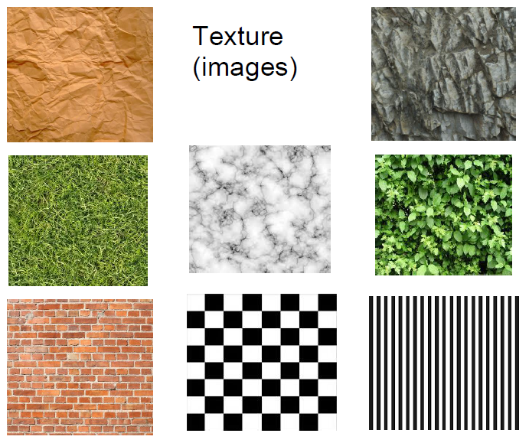
Example of Texture

Slide 13
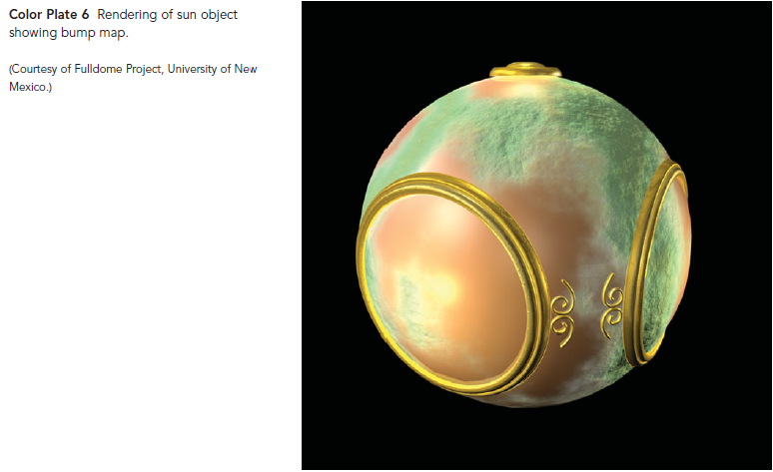
Example of Bump Mapping

Slide 14
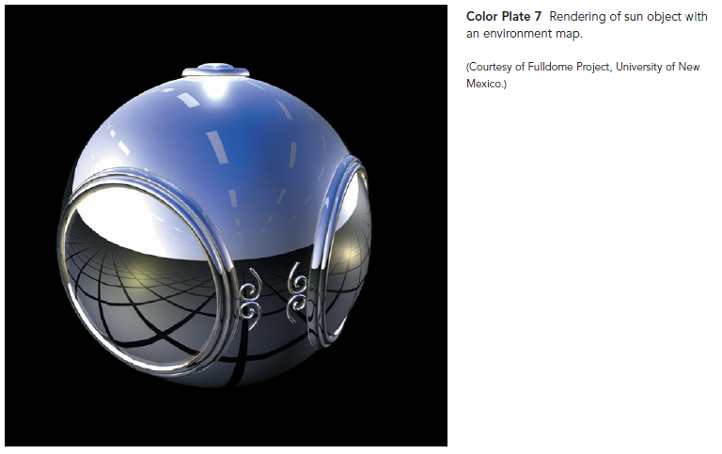
Example of Environment Mapping

Slide 15
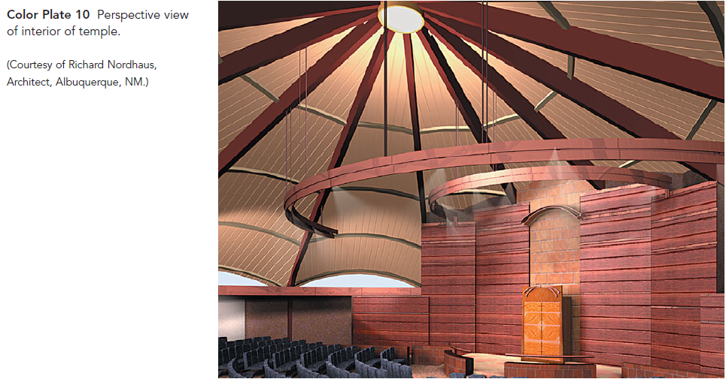
Example of Texture Mapping

Slide 16
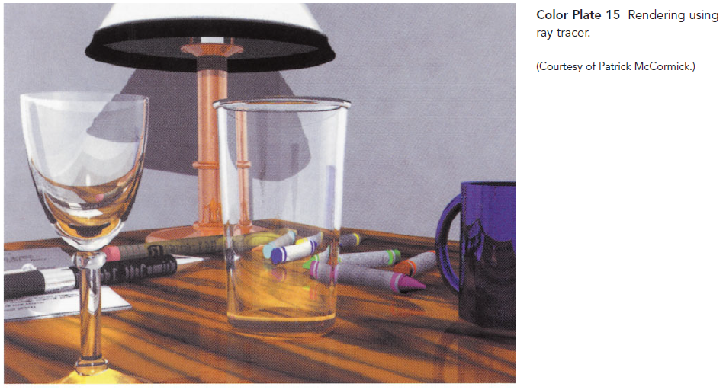
Example of Texture Mapping

Slide 17
Texture Mapping
Textures are patterns. They can range from regular patterns, such as stripes and checkerboards, to the complex patterns that characterize natural materials. In the real world, we can distinguish among objects of similar size and shape by their textures.

Slide 18
Two Dimensional Texture Mapping
Although there are multiple approaches to texture mapping, all require a sequence of steps that involve mappings among three or four different coordinate systems. At various stages in the process, we shall be working with:
screen coordinates, where the final image is produced;
object coordinates, where we describe the objects upon which the textures will be mapped;
texture coordinates, which we use to locate positions in the texture;
and parametric coordinates, which we use to help us define curved surfaces.

Slide 19
What is a texture map?
Practical: “A way to slap an image on a model.”
Better: “A mapping from any function onto a surface in three dimensions.”
Most general: “The mapping of any image into multidimensional space.”

Slide 20
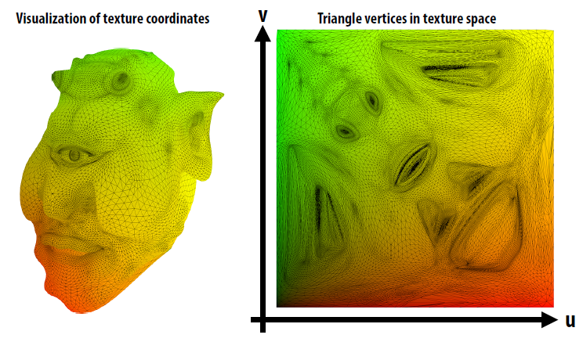
Texture Mapping

Slide 21
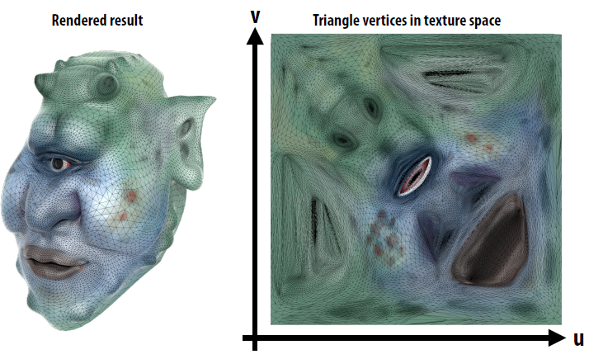
Texture Mapping

Slide 22
Two Dimensional Texture Mapping
In most applications, textures start out as two-dimensional images of the sorts we introduced in page-5 of this slide. Thus, they might be formed by application programs or scanned in from a photograph, but, regardless of their origin, they are eventually brought into processor memory as arrays. We call the elements of these arrays texels, or texture elements, rather than pixels to emphasize how they will be used. However, at this point, we prefer to think of this array as a continuous rectangular two-dimensional texture pattern T(s, t). The independent variables s and t are known as texture coordinates. With no loss of generality, we can scale our texture coordinates to vary over the interval [0,1].

Slide 23
Two Dimensional Texture Mapping
A texture map associates a texel with each point on a geometric object that is itself mapped to screen coordinates for display. If the object is represented in homogeneous or (x, y, z, w) coordinates, then there are functions such that
x = x(s, t),
y = y(s, t),
z = z(s, t),
w = w(s, t).

Slide 24
Two Dimensional Texture Mapping
One of the difficulties we must confront is that although these functions exist conceptually, finding them may not be possible in practice. In addition, we are worried about the inverse problem: Having been given a point (x, y, z) or (x, y, z , w) on an object, how do we find the corresponding texture coordinates, or equivalently, how do we find the “inverse” functions
s = s(x, y, z , w),
t = t(x, y, z , w)
to use to find the texel T(s, t)?

Slide 25
Two Dimensional Texture Mapping
If we define the geometric object using parametric (u, v) surfaces, there is an additional mapping function that gives object coordinate values, (x, y, z) or (x, y, z , w) in terms of u and v.
we also need the mapping from parametric coordinates (u, v) to texture coordinates and sometimes the inverse mapping from texture coordinates to parametric coordinates.

Slide 26
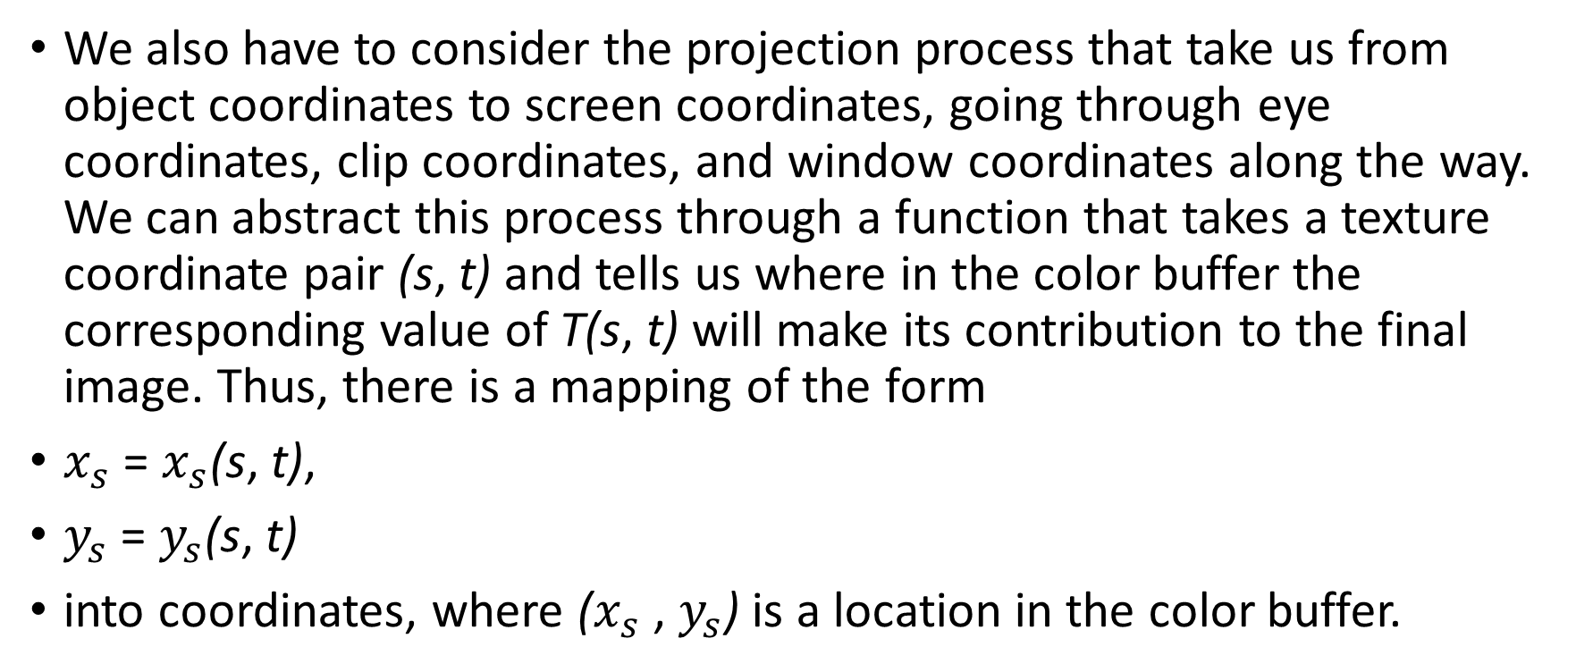
Two Dimensional Texture Mapping
We also have to consider the projection process that take us from object coordinates to screen coordinates, going through eye coordinates, clip coordinates, and window coordinates along the way. We can abstract this process through a function that takes a texture coordinate pair (s, t) and tells us where in the color buffer the corresponding value of T(s, t) will make its contribution to the final image. Thus, there is a mapping of the form
$x_{s}$ = $x_{s}$(s, t),
$y_{s}$ = $y_{s}$(s, t)
into coordinates, where ($x_{s}$ , $y_{s}$) is a location in the color buffer.

Slide 27
Two Dimensional Texture Mapping
One way to think about texture mapping is in terms of two concurrent mappings: the first from texture coordinates to object coordinates, and the second from parametric coordinates to object coordinates, as shown in Figure 7.9. A third mapping takes us from object coordinates to screen coordinates.

Slide 28
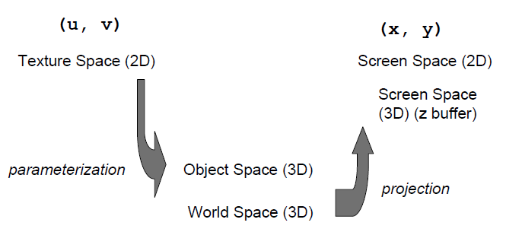
Two Dimensional Texture Mapping

Slide 29
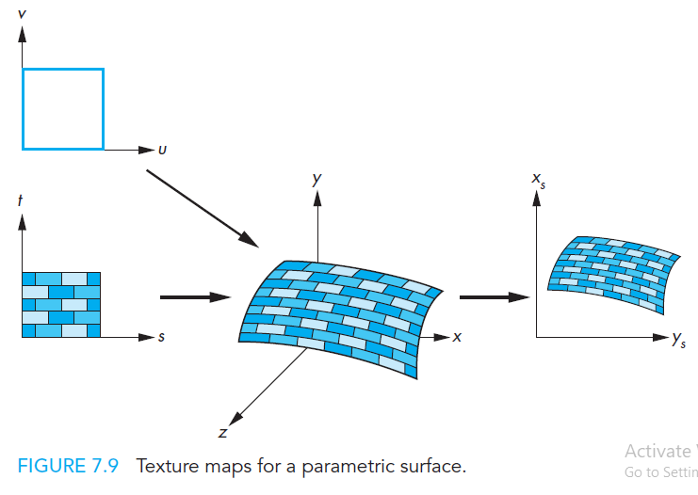
Two Dimensional Texture Mapping

Slide 30
Two Dimensional Texture Mapping
If we assume that the values of T are RGB color values, we can use these values either to modify the color of the surface that might have been determined by a lighting model or to assign a color to the surface based on only the texture value. This color assignment is carried out as part of the assignment of fragment colors.

Slide 31
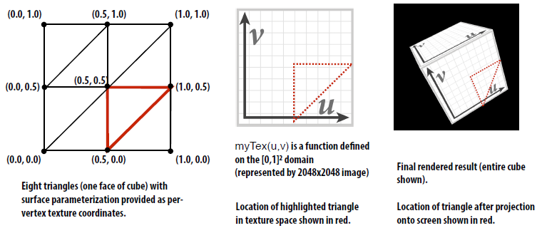
Two Dimensional Texture Mapping

Slide 32
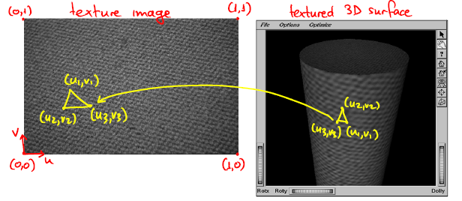
Two Dimensional Texture Mapping

Slide 33
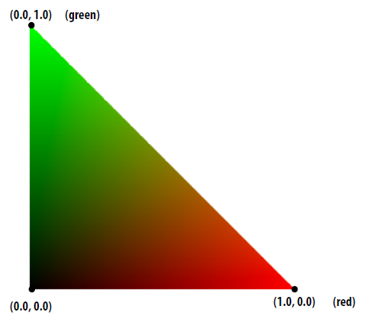
Visualization of texture coordinates
Texture coordinates linearly interpolated over triangle

Slide 34
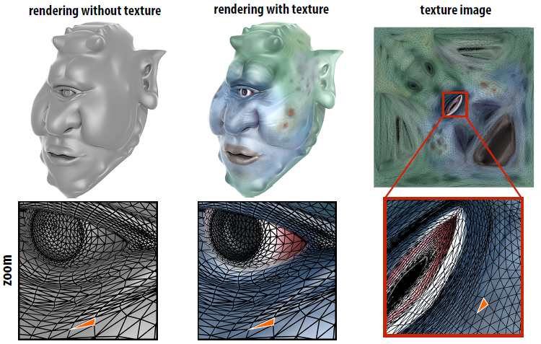
Texture mapping

Slide 35
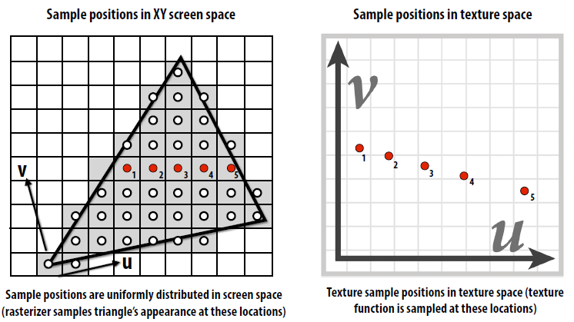
Texture Mapping

Slide 36
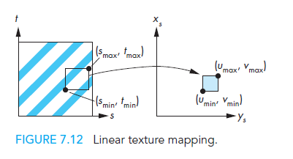
Linear Texture Mapping
Do a direct mapping of a block of texture to a surface patch:

Slide 37
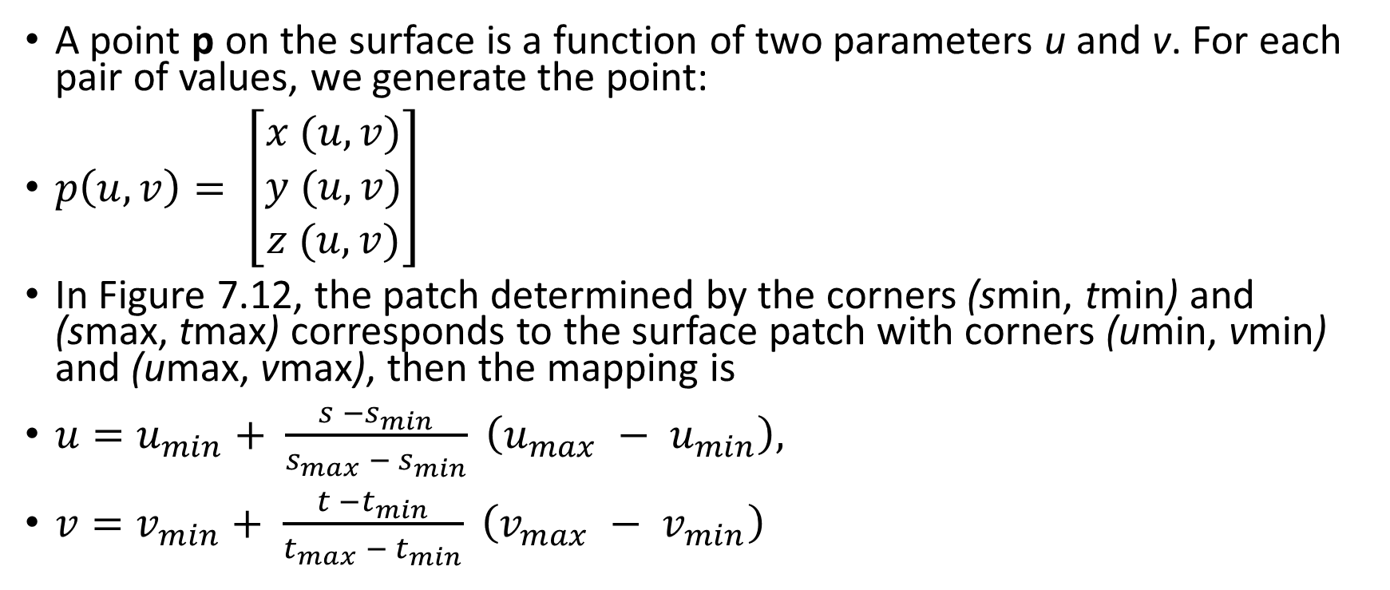
Linear Texture Mapping
A point p on the surface is a function of two parameters u and v. For each pair of values, we generate the point:
$p\left(u,v\right)= \left[\begin{matrix}x (u,v) \\ y (u,v) \\ z (u,v)\end{matrix}\right]$
In Figure 7.12, the patch determined by the corners (smin, tmin) and (smax, tmax) corresponds to the surface patch with corners (umin, vmin) and (umax, vmax), then the mapping is
${u=u}_{min}+ \frac{s −s_{min}}{s_{max} − s_{min}} \left(u_{max} − u_{min}\right),$
${v=v}_{min}+ \frac{t −t_{min}}{t_{max} − t_{min}} \left(v_{max} − v_{min}\right)$

Slide 38
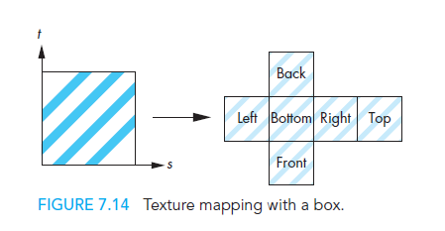
Cube Mapping
“Unwrap” cube and map texture over the cube.

Slide 39
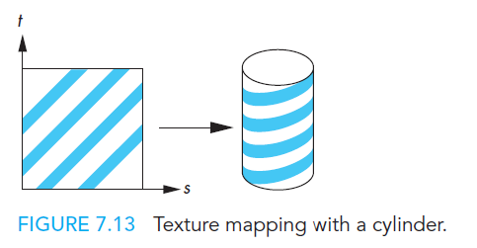
Cylinder Mapping
Wrap texture along outside of cylinder, not top and bottom
This stops texture from being distorted

Slide 40
Cylinder Mapping
in Figure 7.13. Points on the cylinder are given by the parametric equations
x = r cos(2πu),
y = r sin(2πu),
z = v/h,
as u and v vary over (0,1). Hence, we can use the mapping
s = u,
t = v.

Slide 41
Two-part Mapping
To simplify the problem of mapping from an image to an arbitrary model, use an object we already have a map for as an intermediary!
Texture -> Intermediate object -> Final model
Common intermediate objects:
Cylinder
Cube
Sphere

Slide 42
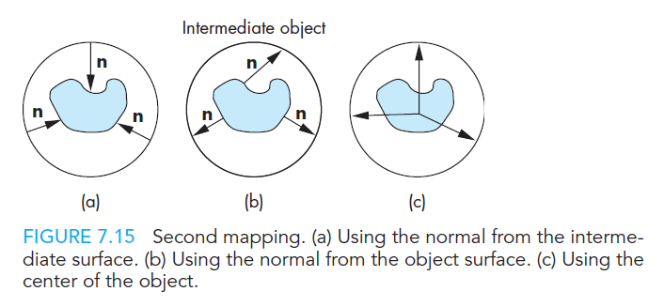
Intermediate Object to Model
This step can be done in many ways:
Normal from intermediate surface
Normal from object surface
Use center of object

Slide 43
Difficulties in Texture Mapping
First, we must determine the map from texture coordinates to object coordinates. A two-dimensional texture usually is defined over a rectangular region in texture space. The mapping from this rectangle to an arbitrary region in three-dimensional space may be a complex function or may have undesirable properties. For example, if we wish to map a rectangle to a sphere, we cannot do so without distortion of shapes and distances.
Second, owing to the nature of the rendering process, which works on a pixel-by-pixel basis, we are more interested in the inverse map from screen coordinates to texture coordinates.

Slide 44
Difficulties in Texture Mapping
Third, because each pixel corresponds to a small rectangle on the display, we are interested in mapping not points to points, but rather areas to areas. Here again is a potential aliasing problem that we must treat carefully if we are to avoid artifacts, such as wavy sinusoidal or moire’ patterns.

Slide 45
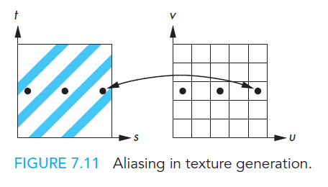
What is aliasing?
An on-screen pixel does not always map neatly to a texel. Particularly severe problems in regular textures.

Slide 46
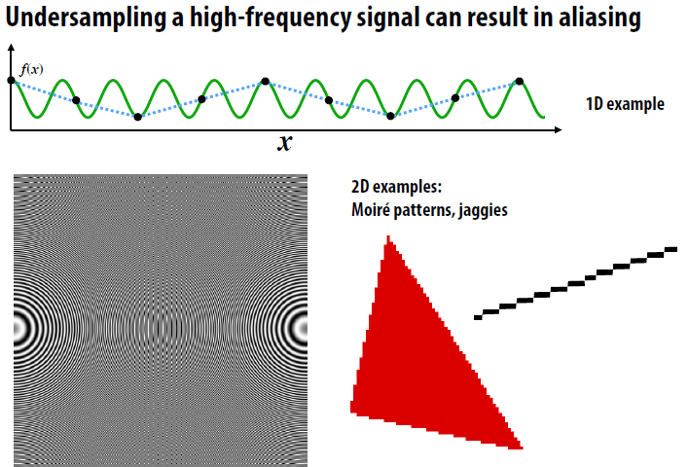
Aliasing

Slide 47
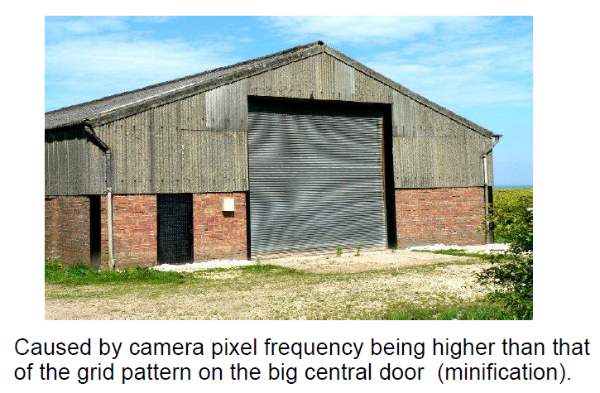
Moire Pattern

Slide 48
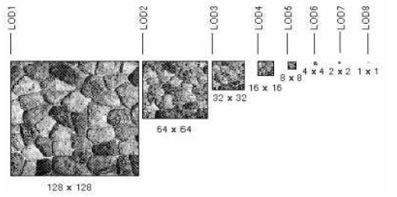
Anti-Aliasing
Pre-calculate how the texture should look at various distances, then use the appropriate texture at each distance. This is called mipmapping.

Slide 49
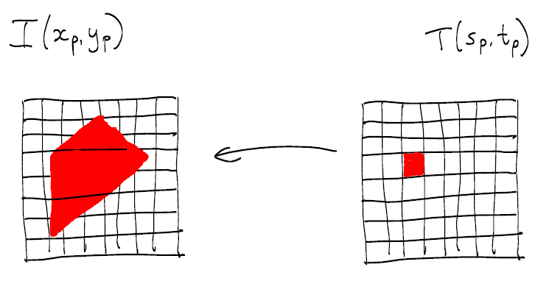
Texture magnification
a pixel in texture image ('texel') maps to an area larger than one pixel in image

Slide 50
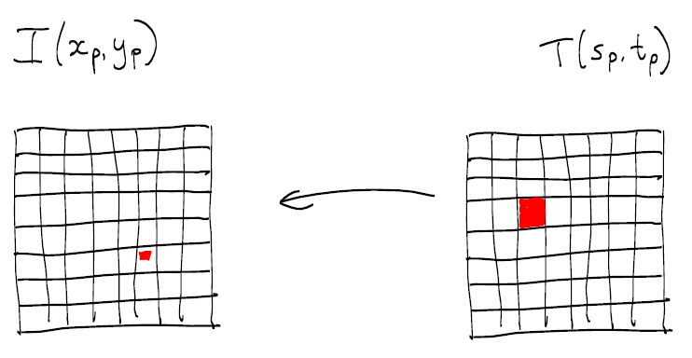
Texture minification
a pixel in texture image('texel') maps to an area smaller than a pixel in image:

Slide 51
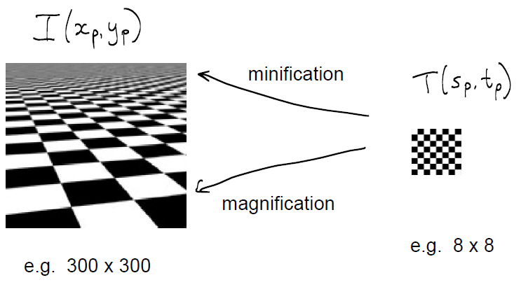
Mipmapping

Slide 52
Anti-Aliasing
Another approach: Filtering- 1. Bi Linear Filtering 2. Tri Linear Filtering 3. Anisotropic Filtering

Slide 53
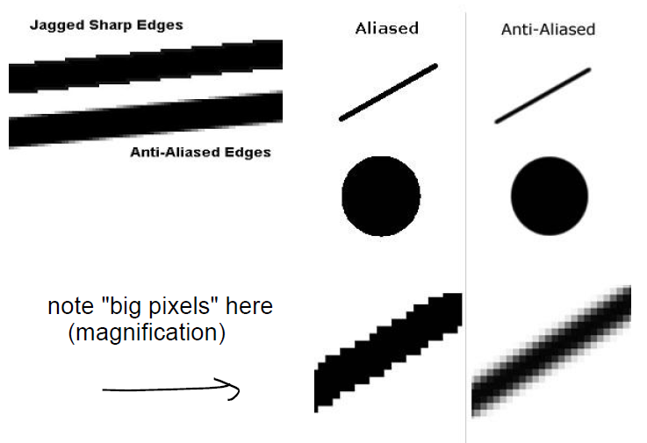
Aliasing and Anti-aliasing

Slide 54
OpenGL Texture Mapping
OpenGL’s texture maps rely on its pipeline architecture. We have seen that there are actually two parallel pipelines: the geometric pipeline and the pixel pipeline. For texture mapping, the pixel pipeline merges with fragment processing after rasterization, as shown in Figure 7.16. This architecture determines the type of texture mapping that is supported. In particular, texture mapping is done as part of fragment processing. Each fragment that is generated is then tested for visibility with the z-buffer. We can think of texture mapping as a part of the shading process, but a part that is done on a fragment-by-fragment basis.

Slide 55
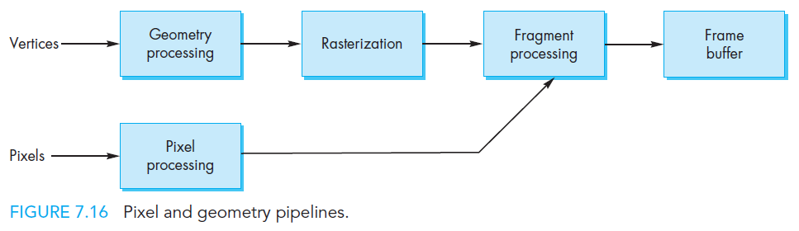
Texture Mapping Pipeline

Slide 56
OpenGL Texture Mapping
Texture mapping requires interaction among the application program, the vertex shader, and the fragment shader. There are three basic steps. First, we must form a texture image and place it in texture memory on the GPU. Second, we must assign texture coordinates to each fragment. Finally, we must apply the texture to each fragment.

Slide 57
glBindTexture
glBindTexture(GL_TEXTURE_2D,textureName);
GL_TEXTURE_2D: Specify that it is a 2D texture
textureName: Name of the texture

Slide 58
glTexImage2D
glTexImage2D(GL_TEXTURE_2D, level, components, width, height, border, format, type, tarray)
GL_TEXTURE_2D: Specify that it is a 2D texture
Level: Used for specifying levels of detail for mipmapping
Components: Generally is 0 which means GL_RGB, Represents components and resolution of components
Width, Height: The size of the texture must be powers of 2
Border Format: Specify what the data is (GL_RGB, GL_RGBA, …)
Type: Specify data type (GL_UNSIGNED_BYTE, GL_BYTE, …)

Slide 59
glTexParameteri
glTexParameteri(GL_TEXTURE_2D, GL_TEXTURE_MAG_FILTER, GL_LINEAR);
This function sets several texture mapping parameters. These parameters are bound to the current texture state that can be made current with glBindTexture.
parameters:
P1: GLenum: The texture target for which this parameter applies. Must be one of GL_TEXTURE_1D, GL_TEXTURE_2D, GL_TEXTURE_3D, or GL_TEXTURE_CUBE_MAP.
P2: GLenum: The texturing parameter to set. GL_TEXTURE_MAG_FILTER Returns the texture magnification filter value
P3: GLfloat or GLfloat* or GLint or GLint*: Value of the parameter specified by pname.

Slide 60
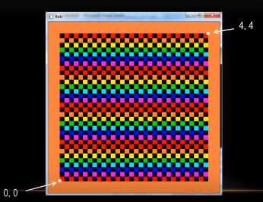
GL_REPEAT Instead of GL_LINEAR

Slide 61
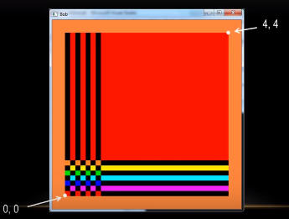
GL_CLAMP

Slide 62
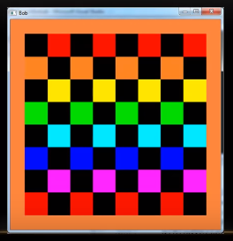
GL_NEAREST

Slide 63
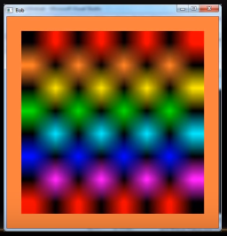
GL_LINEAR

Slide 64
glTexGen
void glTexGeni( GLenum coord, GLenum pname, GLint param);
glTexGen selects a texture-coordinate generation function or supplies coefficients for one of the functions. coord names one of the (s, t, r, q) texture coordinates; it must be one of the symbols GL_S, GL_T, GL_R, or GL_Q.
Coord: Specifies a texture coordinate. Must be one of GL_S, GL_T, GL_R, or GL_Q.
Pname: Specifies the symbolic name of the texture-coordinate generation function or function parameters. Must be GL_TEXTURE_GEN_MODE, GL_OBJECT_PLANE, or GL_EYE_PLANE.

Slide 65
glTexGen
Params: Specifies a pointer to an array of texture generation parameters. If pname is GL_TEXTURE_GEN_MODE, then the array must contain a single symbolic constant, one of GL_OBJECT_LINEAR, GL_EYE_LINEAR, GL_SPHERE_MAP, GL_NORMAL_MAP, or GL_REFLECTION_MAP. Otherwise, params holds the coefficients for the texture-coordinate generation function specified by pname.

